Slide 1

Premier League Data Analysis & Prediction
Haris Šuta
Vedad Kruho
Faris Balić

Slide 2

Introduction:
We analyzed a comprehensive dataset covering the last five seasons of the Premier League.
The initial phase involved intensive data cleaning to ensure the reliability of all results.
We verified statistical anomalies, such as the record-breaking 7.0 xG in the Liverpool vs. Newcastle match.
Our team corrected formatting errors in formations and removed redundant data columns.
We engineered new performance metrics, including goal difference and numerical encoding for venues and results.

Slide 3
Predictive Modeling (Python) – Case 1
The goal was to develop a system that estimates win probabilities for any specific match-up.
We created a custom performance score using Expected Goals, Expected Goals Against, and Shots on Target.
Functions for performance score of a team and win probability of a team were defined as main models for getting results.
We tested the model on an Aston Villa Club and also checked by hand result against Liverpool to analyze if model satisfies calculation.
Results were given in histogram form with Aston Villa estimated win probability against sample of teams and team performance of each team.

Slide 4
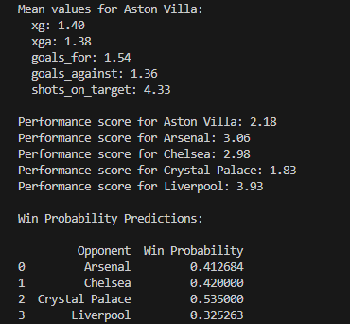
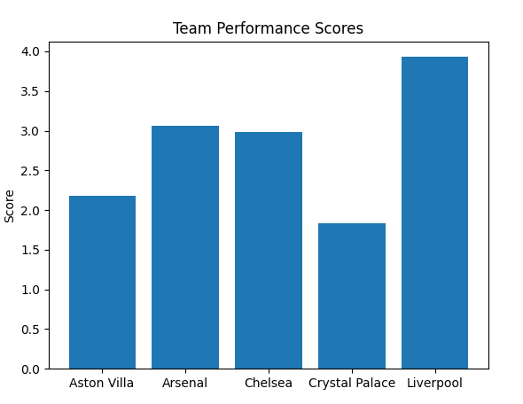
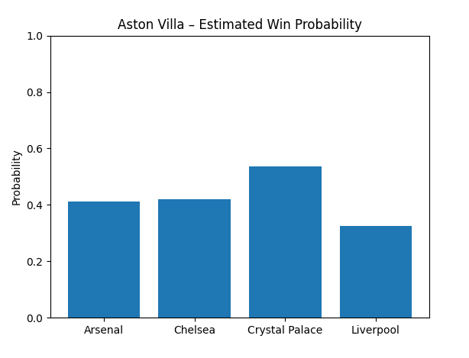
Python output example – Case 1:

Slide 5
Train/Test Modeling (Python) – Case 2
The goal was to develop a system that predicts team probability using more advanced model – Test/Train Model (80/20).
Idea is similar like in Case 1, but here we take 80% of data as train model and record 20% of data as test model and compare with actual values.
Model accuracy - out of all matches model predicts correct outcome in 65.06%, which is better than random guessing (50%).
For Aston Villa case, model was correct in 52%, which is expected as this team is solid team, usually in the middle of a table, so prediction is more difficult.
Interpretation of the results - if the bar from 0.1–0.2 on the x-axis has a height of 5, it means there are 5 matches where the model predicted a 10–20% chance of Aston Villa winning.

Slide 6
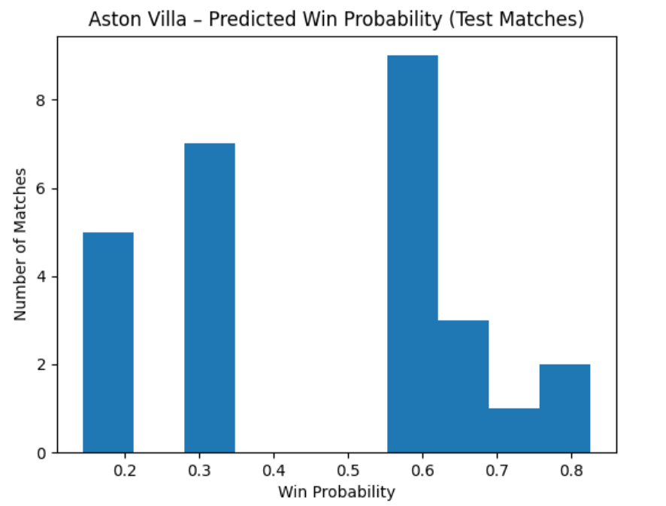

Python output example – Case 2:

Slide 7

Descriptive Analysis (Excel)
We identified tactical trends and correlations within the league data using Excel.
The analysis investigated the relationship between possession percentages and match outcomes.
We quantified the statistical impact of the "Home Advantage" across multiple seasons.
Our research evaluated which formations lead to the lowest Expected Goals Against.
Pivot tables were utilized to aggregate team statistics and compare seasonal performance trends.

Slide 8
Win average per team

Slide 9
Average goals per team & Goals for xg difference per team

Slide 10

Business Intelligence Dashboard (Power BI)
The Power BI phase focused on transforming data into an interactive visual story.
We developed a professional interface that allows for easy navigation of complex stats.
Users can use interactive slicers to filter the data by team, season, or specific venue.
The dashboard features dedicated pages for tracking team form and head-to-head comparisons.
All engineered features were integrated to provide a deep-dive into Premier League performance.

Slide 11
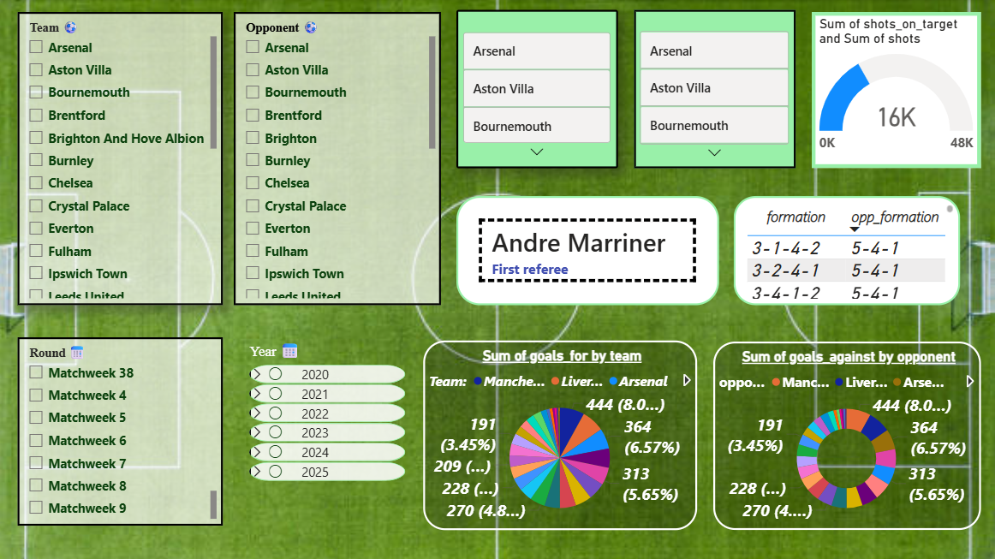
Representation of a table

Slide 12

Conclusion
Thorough data cleaning and normalization served as the critical foundation for the project.
The predictive model reached a 65.06% accuracy rate, proving to be a reliable forecasting tool (without advanced tools or ML).
Technical metrics like xG and Shots on Target were identified as the strongest indicators of success.
We successfully created a BI solution that combines historical insights with future predictions.

Slide 13
Thank you for your attention Any questions?

